Slide 1
Design Team:
Chandler North, Craig Biesinger, Isaac Johnson, and Parisa Mardanlou
Notes:
Hello everybody and welcome to our project presentation for our service I know A Guy By:

Slide 2
Project Overview
For our final project, we devised the idea for a whole new website/app called iknowaguy.com. A website that connects homeowners with local contractors in which homeowners can reach out to the contractors for their services. Get a quote for services, schedule appointments, and leave reviews. The service will allow users to rate contractors based on punctuality, getting work done in a timely manner, fair pricing, and quality of work. So that future users can see which contractors are better than others.
Notes:
For the final project we decided on the creation of a whole new service where users can find vetted and certified contractors (I.e painters,plumbers landscapers) all within our site to really to dull the headache that is hiring someone to work on your home

Slide 3
Finding a good contractor for a project is important as it can impact the success, safety, and quality of the project. A reliable contractor brings expertise, experience, and professionalism to the table, ensuring that the work is completed properly. Hiring a bad contractor can lead to problems that can be costly, frustrating, and unsafe. From delivering quality craftsmanship to managing the project efficiently, a good contractor saves time, money, and potential headaches. By investing in a reputable contractor, users can be confident that their project is in good hands.
Notes:
Talk about frustrating process of finding someone to work on your home

Slide 4
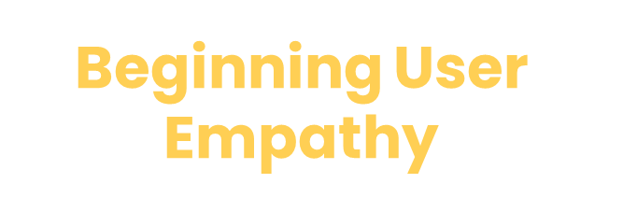
How did this all start?
We are born out of frustration.
We simply want to get things done.
We want to provide a smooth experience because we ourselves want a smooth painless experience
Notes:
Isaac-iknowaguy was born out of frustration frustration of property owners wanting a smooth safe experience when it comes to finding people to do contract work on their homes. Talk about experiences with getting work done

Slide 5
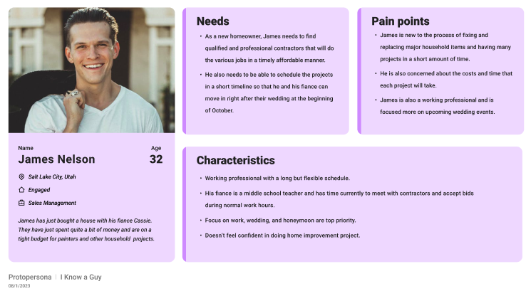
Proto-Persona
Notes:
For our proto persona we thought of James Nelson a 32 year old who works in sales management. Who wants an easy experience when it comes to hiring help for his home he
Is a busy man and does not want to take weeks or months to get work started on his home.

Slide 6
Research

Slide 7
Interviews
What issues, if any, do you have with finding contractors to work on your home?
For our research, we chose home and property owners for our pool of interviewees.
We decided to do face to face, semi-structured interviews asking our interviewees their experience with contract work.
Motivation/Pain Points: Wanted to see what potential users would want in a service like ours.
What are some features you would like to see on a service like ours?
User Interviews Responses

Slide 8
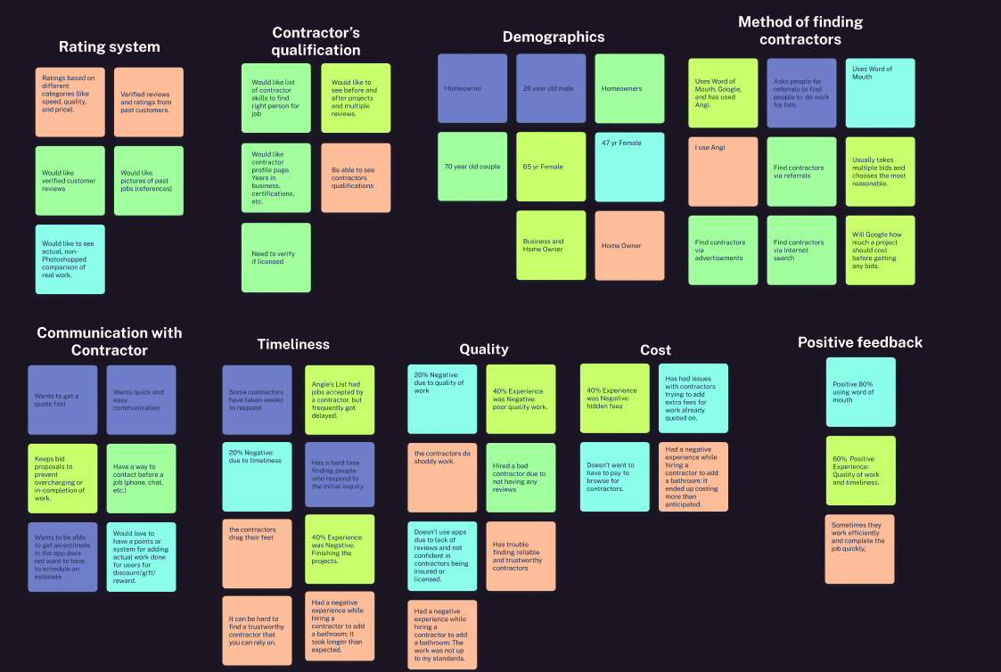
Affinity
Diagram
Affinity Diagram in Figma

Slide 9
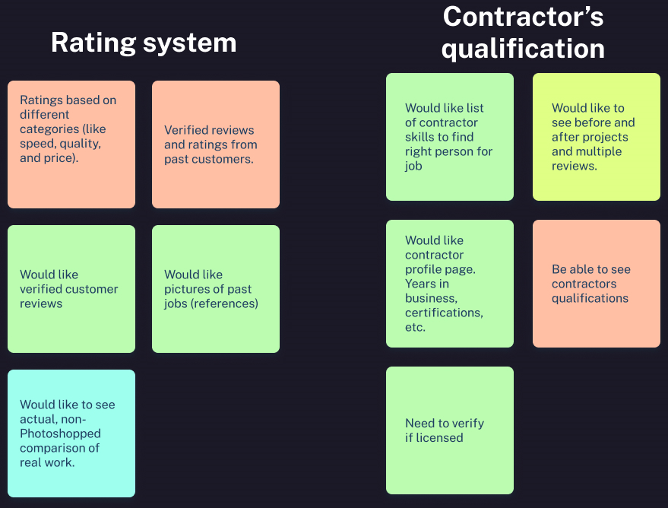
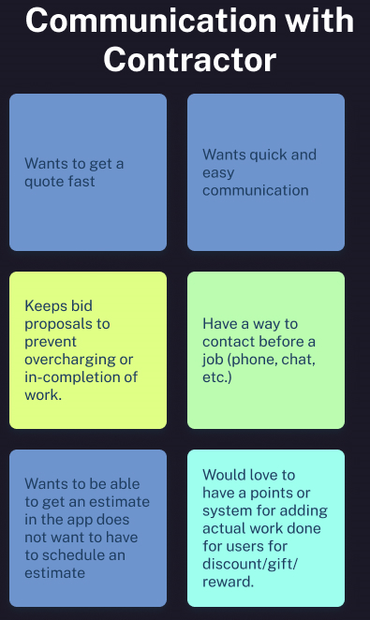
Major Qualities That Users Needed

Slide 10
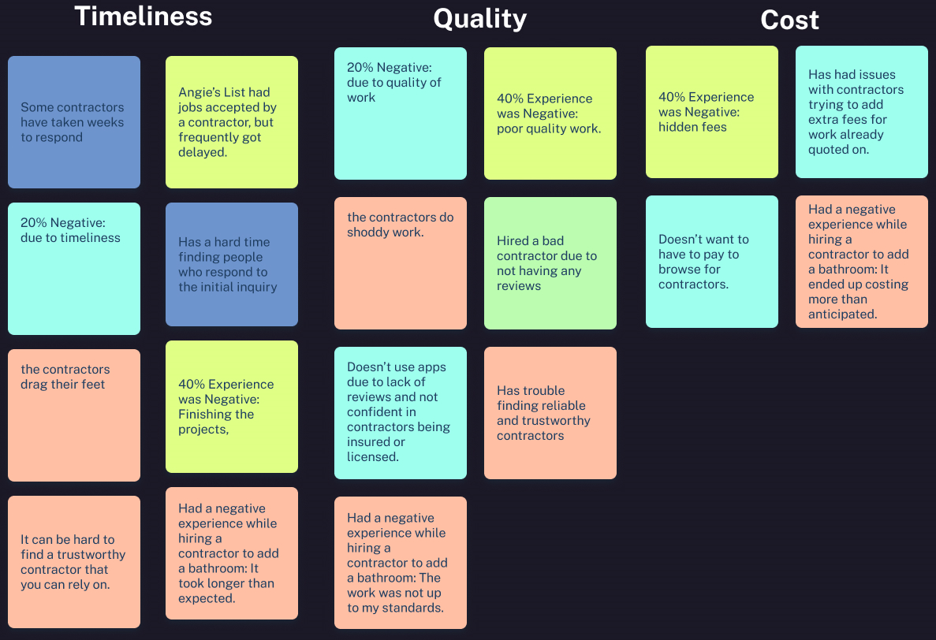
Major Pain Points Users Faced

Slide 11
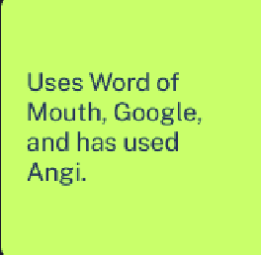
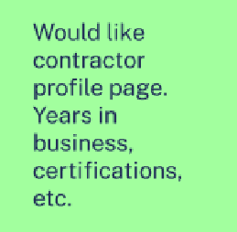
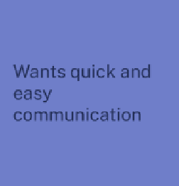
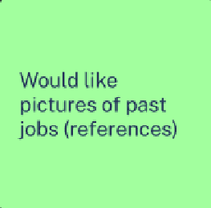
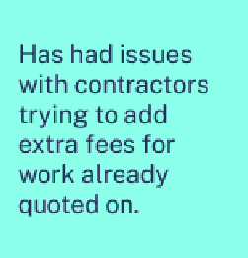
Key Takeaways

Slide 12
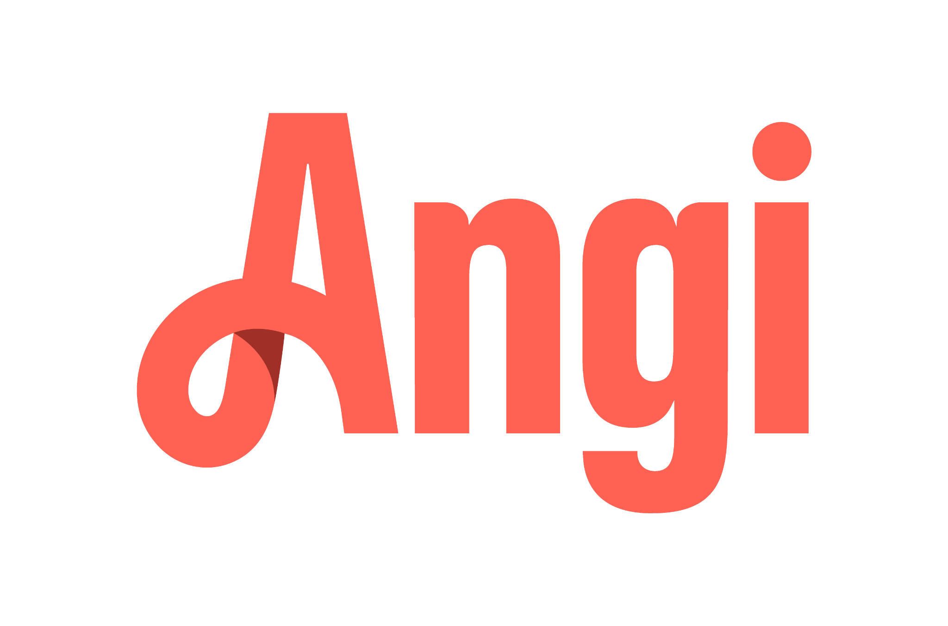
Competitive Analysis
Direct
Indirect
Angi (Formally Angies List)
Vetted, it’s been around for years merged with Homeadvisor.
Has a 1.9/5 rating on the Better Business Bureau.
Have to sign up in order to view contractors in your area.
Instagram
Contractors can show completed projects.
Can directly message contractor.
Space is not specifically meant for contractors.
Word of Mouth
Contractors can be vetted by people you trust, “I know a guy”.
Could view work done in person
Person referring could leave details out
Thumbtack
Good SEO (3rd on organic search for contractors).
Insurance if project goes south.
Changed to a paid subscription for contractors.
Take Me There

Slide 13
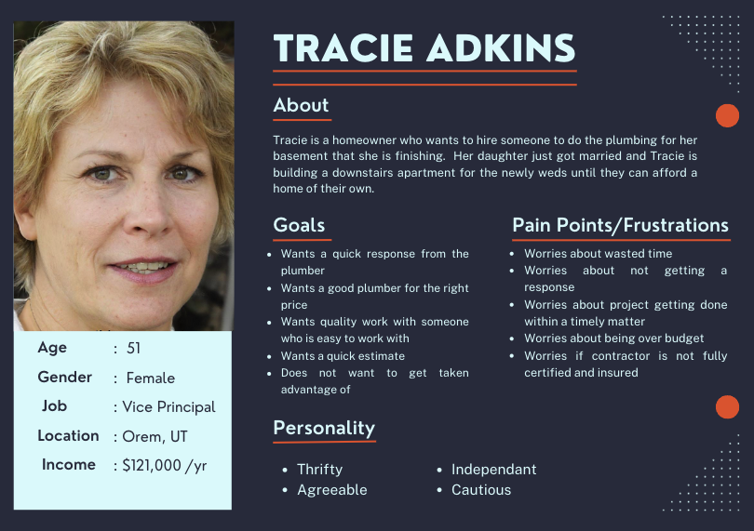
User Persona

Slide 14
Ideation

Slide 15
User Insight/Problem Statement
User Insight:
Tracie is adaptable. With a career in the education system, she has to be. Converting her basement into an apartment is uncharted territory but she feels up to the task if she can find the right help.
Problem Statement:
Tracie has made her living being the expert, but she knows when to defer to someone else’s expertise. With a large plumbing project coming up, how can we make it easy for her to find the right people for the job?
Notes:
Here we have our user insight and problem statement which give us an understanding the concerns she will have with the process of finding someone to work on her home as well as what we can provide our potential users.

Slide 16
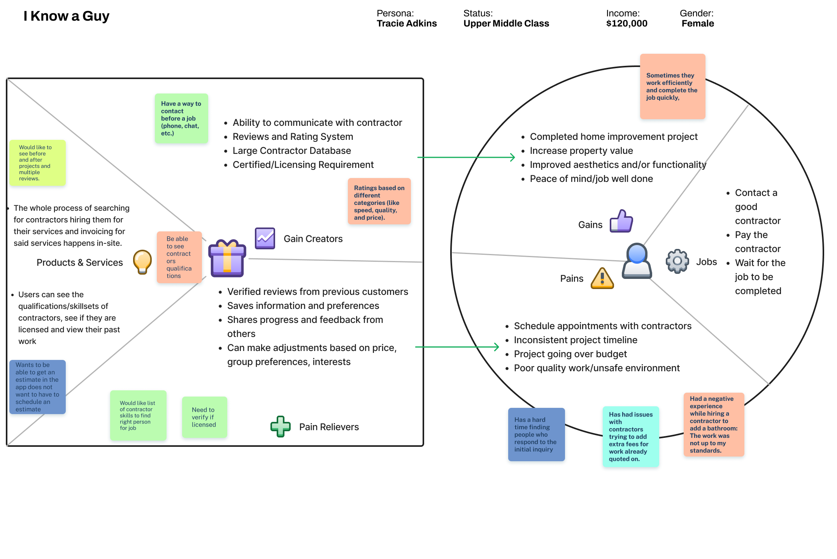
Value Proposition
Iknowaguy.com is a website that connects homeowners with local contractors. Customers can research projects and contractors, get a quote for services, schedule appointments, process billing, and leave reviews. Iknowaguy.com is a one-stop shop for both customers and contractors.
Notes:
WIth our value proposition we wanted to show that iknowaguy.com is like we say “the one stop shop for both customer and contractors” our interviewees
And potential users want assurance because when your talking about home renovations its not a process that should be taken lightly we want to be the pain reliever for the user a painless and secure experience is the experience we want to provide provide a papertrail so that someone doesnt just take their money and run

Slide 17
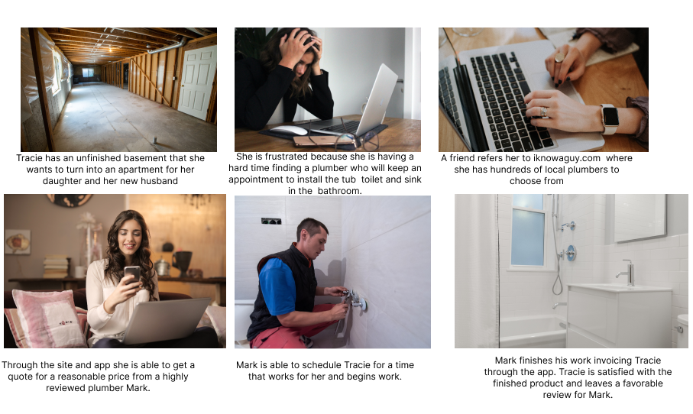
Storyboard
Notes:
Our storyboard enabled us to join the journey that Tracie is going on and give us an idea of how she is feeling the process as you can see she is very frustrated and Mark did a killer job

Slide 18
Journey Map
Notes:
Our journey map really fleshes out tracies feelings during this process as you can see by step three she is steamin mad she has had multiple no shows and contractors simply not respond to her you can see by step 7 she is shook by the response time and how starting a job and getting a quote is truly a breeze using iknowaguy

Slide 19
User Flow
Link
Notes:
With our user flow we wanted to show the flow of what a potential or new user would see when they first sign up for the site as you can see they are able to browse for contractors in their area to see who is available unlike Anji where you have to sign up just to see who is around but if the user wants to actuall reach out to a contractor they have to sign up with the service to begin the process of starting a job on their home

Slide 20
Prototyping, FE Dev,
Testing

Slide 21
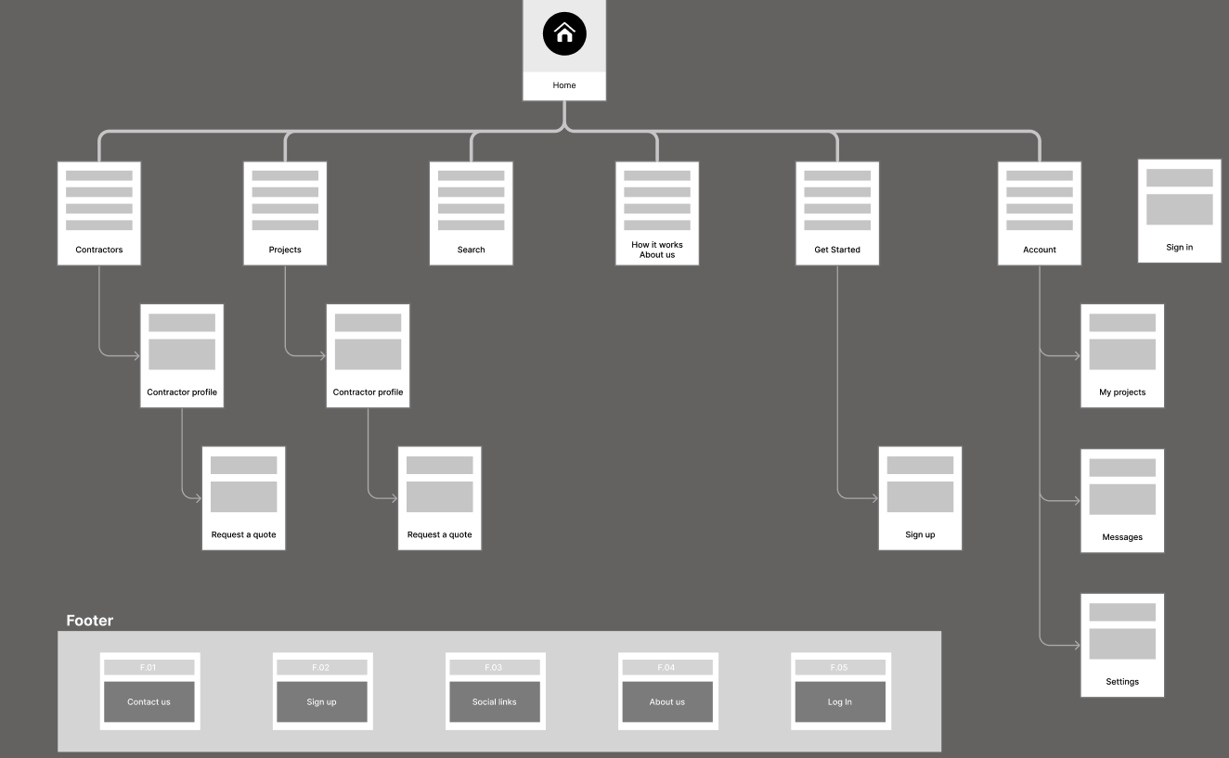
Site Map

Slide 22
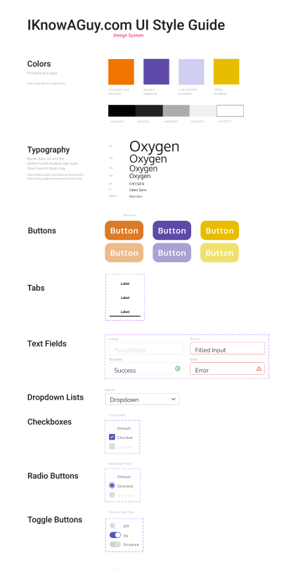
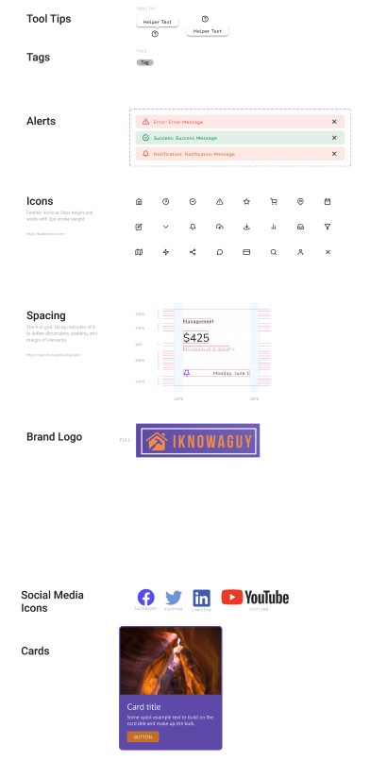
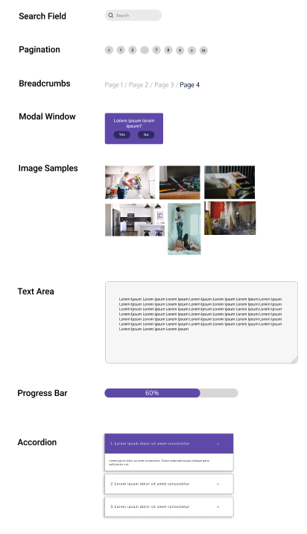
UI Style Tile
Link

Slide 23
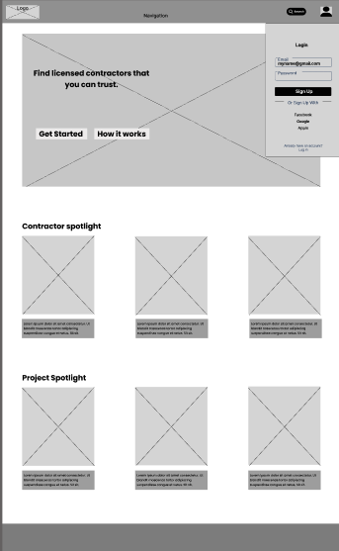
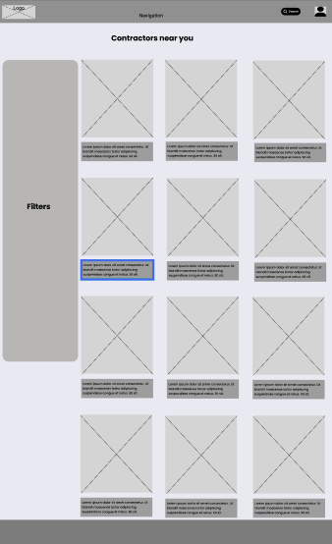
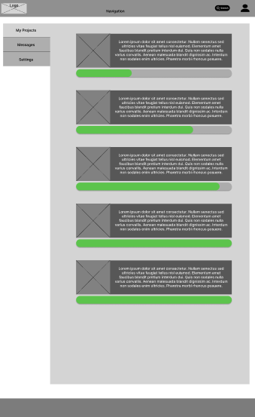
Wireframing & Testing
Notes:
User testing revealed that finding the contractor profile page via the search was a little confusing. We determined that could be fixed by creating links between the profile page and additional text/media elements within the search. We carried that same lesson over to the messages page and added easily accessible links there as well.

Slide 24
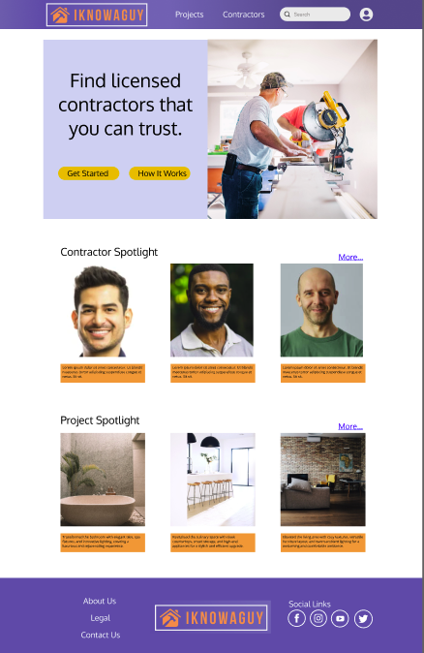
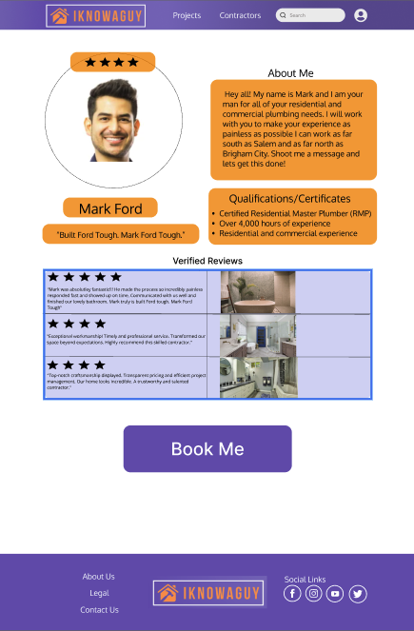
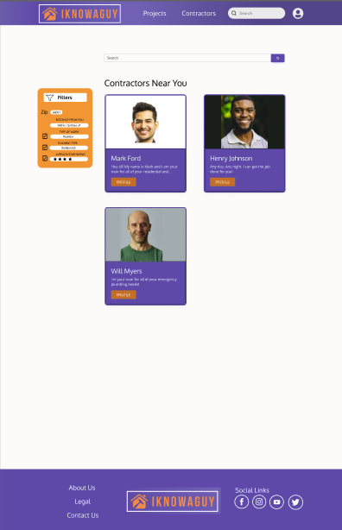
Prototype
Figma Link

Slide 25
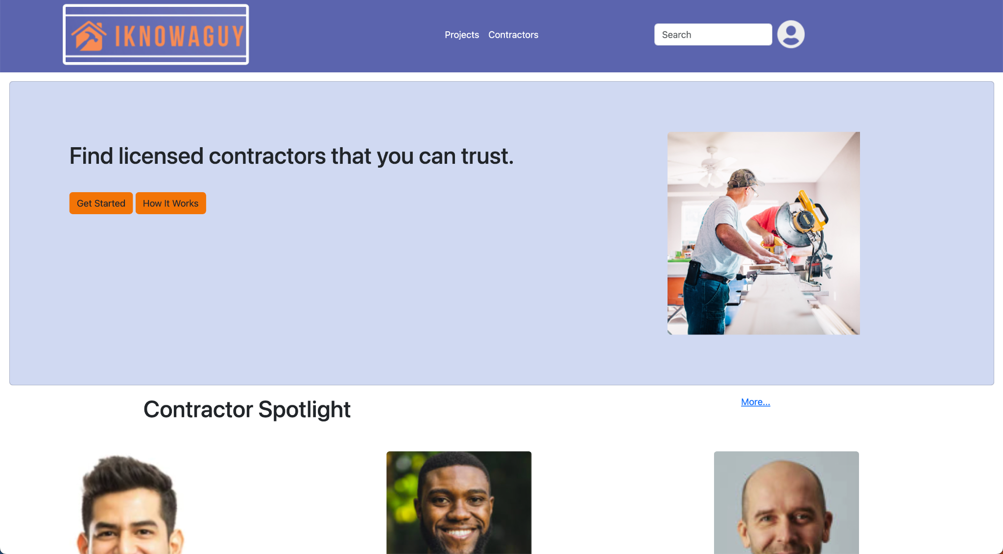
Website
Repository Link
Website

Slide 26
Where do we go from here?
Some of the features we would like to include from here are:
Additional features like an in-site/ in app estimate tool
The Contractor Portal
In-site billing
More consistency in RWD

Slide 27
Thank You!

